Slide 1

Early detection of lung cancer using machine learning
Project Guide : Prof Mr. K. S . Kadam

Slide 2
LUNG CANCER
Introduction to
There are about 2.5 million people get diagnosed with lung cancer a year.
It is estimated that around 12,303 individuals had lung cancer in 2016, 7130 males and 5073 females ; deaths from lung cancer were 8839.

Slide 3
LUNG CANCER
Introduction to

Slide 4

LUNG CANCER
Introduction to
Prostate Cancer
307,000 Deaths
Colorectal Cancer
694,000 Deaths
2/3
That get diagnosed early survive
Breast Cancer
522,000 Deaths
Lung Cancer
1,590,000 Deaths

Slide 5
LITERATURE REVIEW
Image processing techniques proposed by Sangamithraa & Govindraju with a back propagation neural network yields the highest outcomes using an LIDC ( Lung Image Database Consortium ) dataset with and accuracy of 90.65%.
Vijaya, Suhasini and Selvi proposed an image processing techniques which produces an accuracy of 72.5%. They had used four core level where enhancement, segmentation, pixel value matching and feature extraction which became very lengthy and leads to less accuracy.
In this paper(Kaucha 2017), median filter, wiener filter is used in the pre-processing stage to enhance the quality of image and increase the accuracy up to 95%. Different combinations of image processing techniques and algorithms have been proposed with different outcomes in terms of accuracy, sensitivity and specificity.

Slide 6
PROBLEM STATEMENT
Early detection of Lung cancer using Image processing and Machine Learning.

Slide 7
OBJECTIVES
To improve the efficiency in detecting the Lung Cancer by performing image processing and using SVM.
Using Discrete Waveform Transform for image compression and extracting features using Grey Level Co-occurrence Matrix (GLCM).
Using Support Vector Machine as classifier, separating hyper plane – a Machine learning algorithm.

Slide 8
PROPOSED WORK
Image processing algorithms have been proposed to diagnose the early stages of lung cancer where the threshold value of the lung CT image is calculated and segmented.
The candidate nodule is detected and features are extracted.
After that the SVM classifier is used in the classification stage which produces the accuracy of 95%.

Slide 9
SYSTEM ARCHITECTURE
INPUT CT SCAN IMAGE
PREPROCESSING
SEGMENTATION
FEATURE EXTRACTION
SVM CLASSIFIER
OUTPUT

Slide 10
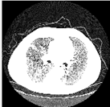
METHODOLOGY AND IMPLEMENTATION
MODULES
Pre – processing The lung CT scans are first converted to a gray scale image so that they can be easily processed using a digital processing technique
a) Input DICOM
b) Gray Structure
c) Gray Scale input

Slide 11
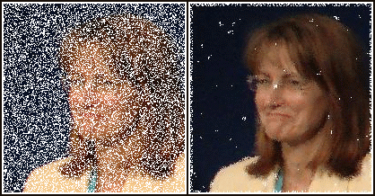
Median Filter Median filter is nonlinear digital filtering technique often used to remove noise from an image or signal
Image with salt and pepper noise
Denoised image after median filter

Slide 12
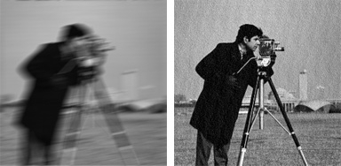
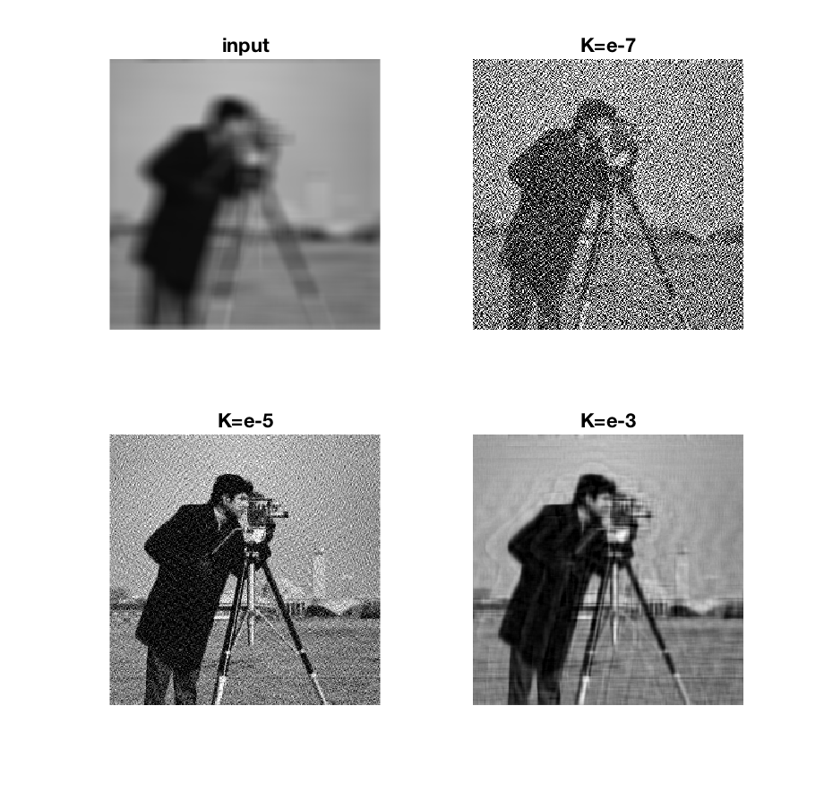
Wiener Filter Wiener filter is a technique for removal of blurriness from images. The inverse filter is a restoration technique.

Slide 13
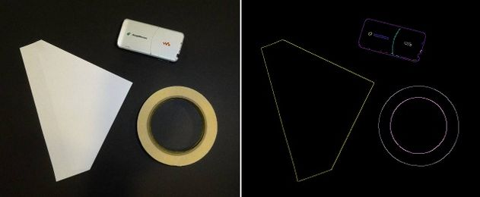
SEGMENTATION
DETECTING EDGES
Applying Canny’s Edge detection algorithm.

Slide 14
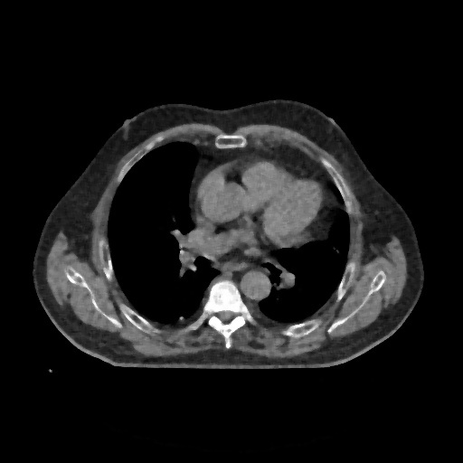
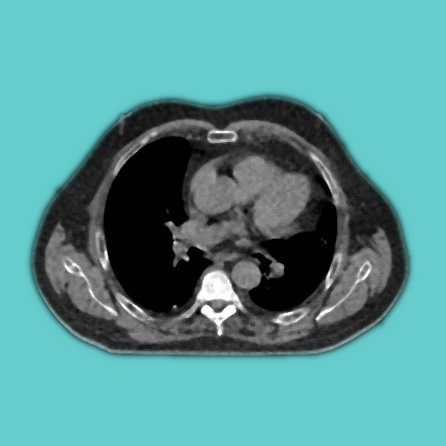
CT SCAN IMAGE AFTER CANN’S EDGE DETECTION

Slide 15
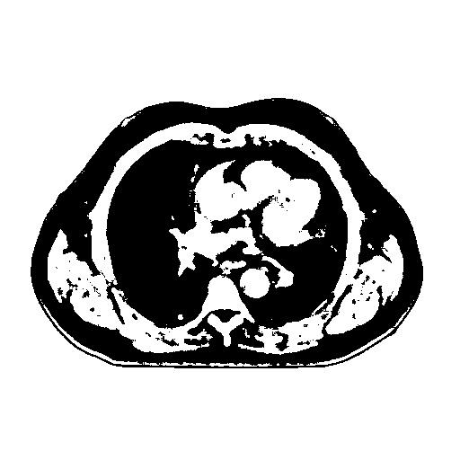
THRESHOLDING

Slide 16
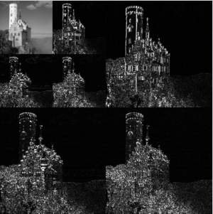
DWT TECHNIQUE The Discrete Waveform Transform (DWT) technique is used in the ROI image.
The multi resolution analysis is carried out by separating low and high level frequency portions of the image using filters

Slide 17
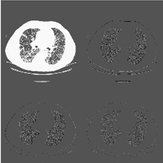
a) ROI Mask
b) 1- Level DWT image
c) 2- Level DWT image

Slide 18
FEATURE SELECTION
GLCM ( Gray Level Co-occurrence matrix) The GLCM (Gray Level Co-occurrence Matrix) characterizes the texture of an image by calculating the value of pairs of pixels with specific value and the spatial relationship and extracts statistical measures from this matrix.
GLCM matrix is calculated in 4 dimensions namely 0°,45°,90°,135°

Slide 19
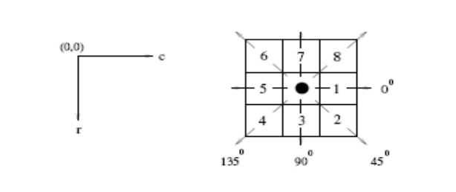
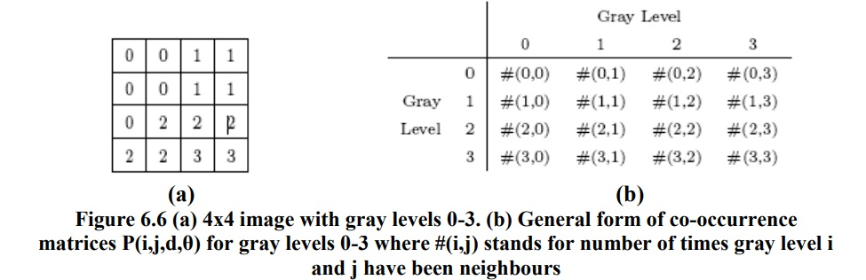

Slide 20
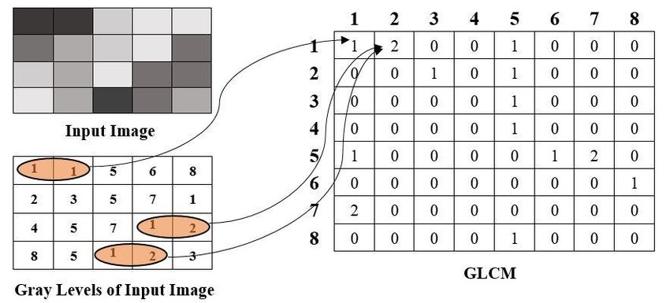

Slide 21
Feature extraction
Feature extraction is process of transforming the input data into set of features which can very well represent the input data.
Features such as entropy, correlation, energy, variance, contrast and dissimilarities are extracted from the sampled image.
Features can be :
Textural Features : Entropy, Homogeneity, Contrast, Dissimilarity
Structural Features : Area, Centroid, Perimeter, Diameter
Statistical Features : Mean Intensity

Slide 22
CLASSIFICATION
In machine learning and statistics,
classification is the problem of identifying to which of a set of categories a new observation belongs
Classification is carried out using an SVM (Support vector machine), classifying whether the image is normal or a tumour.
Classification is carried out on labelled set of data

Slide 23
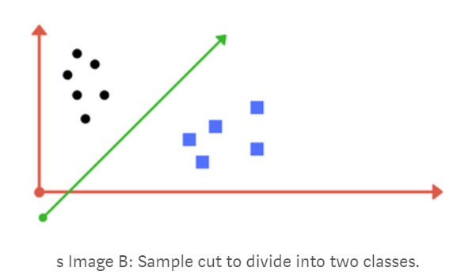
SVMs are supervised learning models which analyze data for classification.
They use optimum linear separating hyper planes which can be used for classification and regression.
Here, the linear kernel SVM is used to classify the image into normal or cancerous images.

Slide 24
APPLICATION
Early detection of lung cancer in medical field.

Slide 25
Thank you

